Slide 1
Welcome
Dean – supporting student success in Newbridge College

Slide 2
THE ROLE OF DEAN
Working with parents and staff to support student success

Slide 3
Dean Contact Details
fifthyeardean1920@newbridge-college.ie
(045) 487249
sixthyeardean1920@newbridge-college.ie
(045) 487292

Slide 4
Newbridge College
Supporting students with additional needs in Newbridge College

Slide 5
Supporting Students with additional needs in Newbridge College
SENCO 1^{st-3rd} Ms Geraldine Mc Dermott
SENCO 4^{th-6th} Ms Jennifer Little
SET team of teachers who focus on learning support
SNA
All students have support from subject teachers, Deans, mentors, school counsellors, school nurse, chaplains, Principal, Deputy Principals, school office, other staff and adults leading extra curricular activities
SPHE/RSE
Events organised during the school year

Slide 6
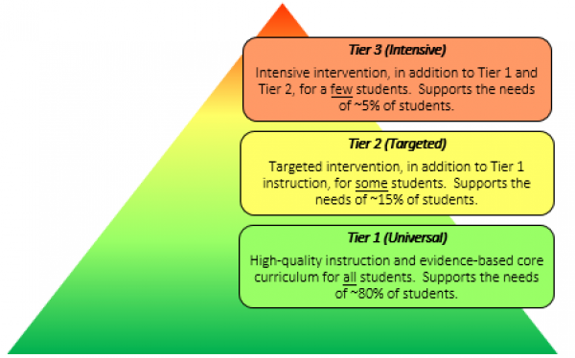
General model of allocation
Resources prioritised based on needs
Needs evidenced in several ways
Screening and testing 1st and 2nd year
Inclusion is a key principle
Co-teaching/support teacher in class

Slide 7
The role of schools in RACE for Junior and Leaving Certificate
Identify students who are eligible for RACE according to the SEC criteria
Prepare RACE applications
Explain RACE to students and parents
Keep records of evidence of eligibility

Slide 8
Working with parents
Share
Share your concerns with us at the earliest opportunity info@newbridge-college.ie
Make
Make reports of assessment and/or intervention available to the school or consult with us about sharing these
Work
Work with your son/daughter’s subject teachers and learning support teachers to maximise their learning
Check
Check the plan/review document we will send at the end of the first term and the third term

Slide 9
5 Core Dimensions to the role:
1. Academic tracking
2. Behaviour Management
3. Operational
4. Year Group Spirit
5. Wellbeing

Slide 10
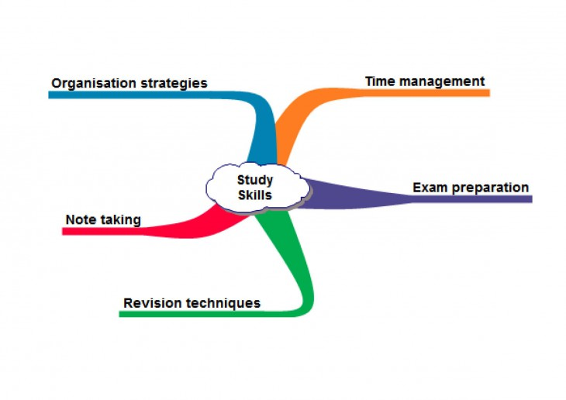
Mentoring in Newbridge College
Supporting students to achieve their potential

Slide 11
What is Mentoring?
A voluntary programme where teachers give their time to work with students on a one-to-one basis
Aimed at students who for various reasons are falling significantly below their potential
Offers support in three ways:
Building Positive Relationships
Academic Coaching to set and realise goals
Study Skills

Slide 12
How Mentoring Works…
Some students put themselves forward
Teachers refer students
Deans identify students through academic tracking
Mentoring is very valuable, but it is a voluntary programme and we can only allocate mentors based on the resources we have available.

Slide 13
Study Skills Seminars
5th Years:
Study Skills Seminar – Amazing Brains
October 7th 2019
6th Years:
Optional Study Skills Seminar
(Outside school hours)

Slide 14
Study & Homework
Need to be organised, focused and hard working
Seek support if needed
Set targets
Revision schedules
Academic achievement

Slide 15
Assessment
Responsibility
Excellence
5th Years:
Christmas Exams
Interim informal exams at Easter
(online results only)
Summer exams
6th Years:
Pre-mocks November
Mock Exams February

Slide 16
Uniform
Responsibility
Pride
Parents: Please check your child’s uniform each morning
Uniform as outlined in the Code of Behaviour
Black leather shoes (with black leather soles)
Non uniform items not allowed (placed in locker at 8.40am-3.40pm)
Outerwear: College fleece or College jacket only
Piercings: No facial piercings (noserings, eyebrow studs or lip rings)
Natural hair colour

Slide 17
2. Behaviour
Responsibility
Empathy
Code of Behaviour – to be reviewed
Essential for effective teaching and learning
Integral part of our school community
In line with Dominican ethos
Building life skills
Promotes positive behaviour
Based on ‘RESPECT’
Tues/Thurs vs. Saturday detention
Vaping
Unexplained absences

Slide 18
Respect
R: Responsibility - We are accountable to ourselves and others for our decisions.
E: Empathy - We take the time to acknowledge and understand others point of view.
S: Safety - We behave in a safe manner and take care of each other.
P: Pride - We take pride in ourselves and our environment.
E: Excellence - We strive to do our best in all areas of our lives.
C: Co-operation - We work together for success.
T: Truth - We speak and act honestly.

Slide 19
Restorative Practices

Slide 20
Anti-bullying & Cyberbullying
Huge emphasis on this in Newbridge College
Anti-bullying/Cyber-bullying team
Parents:
Please monitor your child’s usage of technology
Conversation – Internet Safety
Impact on students learning & study
Impact on students wellbeing

Slide 21
Punctuality
Responsibility
Co-operation
Parents – a key role in students punctuality
8.20am – suggested arrival time
8.40am – school begins
After 8.50am – Late sign in at enquiries
Notes visible in e-diary (frequent parental viewing recommended)
Parent intervention
Saturday detention/formal letter home – repeat offenders
Obvious impact on teaching and learning

Slide 22
Signing – in/out
Responsibility
Safety
N.B: Students give note to Dean in morning only
Exceptional cases – otherwise
Authorised at enquiries
Use of smart card - enquiries
Sign out by own parent only
Late sign-in’s & sign outs – minimal.

Slide 23
4. Year Group RETREATS
Wellbeing focus
Facilitated by staff

Slide 24
5. Wellbeing
Responsibility
Empathy
Safety
New focus for Junior Cycle
Whole school approach
Pastoral care
Promoting social cohesion and an inclusive atmosphere
Supporting positive mental health

Slide 25
Wellbeing – Parental Support
Proactive strategies
Open communication
Consistent monitoring
Early identification of issues
Early intervention
Focus on wellbeing – around examinations
Parental support

Slide 26
Any Questions??

