Slide 1
Newbridge College Ski Trip 2022
Folgaria Italy
19 February – 26 February

Slide 2
EU Digital Passenger Locator Form
From February 1st those arriving from the EU are exempt from having to provide a negative antigen test (taken within 24 hours prior to arrival) or PCR test (taken within 48 hours prior to arrival)
Must be filled out by the passenger
Print the Locator Form
Have a copy on the phone
Here is the link
https://app.euplf.eu/#/#
Must use Students e-mail not parents

Slide 3
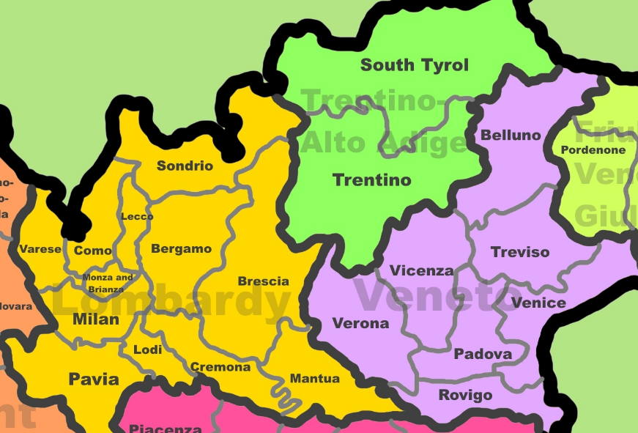
Some details required for the Passenger Locator Form
Verona Flight arrives
Provence Veneto
Milan Flight arrives
Provence: Lombardy
Our Accommodation
Provence: Trentino
Hotel
Hotel Miramonti
Via Dante Alighieri 12
38064
Folgaria TN

Slide 4
Depart Newbridge College
Saturday 19 February 2022
First Flight Girls + 6 Boys
3.30am Back Car Park Newbridge College
Inform your supervising teacher that you have arrived
Second Flight Boys
4.30am Back Car Park Newbridge College
Inform your supervising teacher that you have arrived
Notes
If you are going straight to Dublin Airport you must let us know
If you are collecting your son/daughter from the airport please make sure you inform us at the time
We can’t stop on the way up or back

Slide 5
Flight Details
Girls Flight + 6 Boys Departure Times
EI 412 Dublin to Verona 6.15 Saturday 19 February 2022(Arrive 10.00)
Return Flight
EI 413 Verona to Dublin 10.45 Saturday 26 February 2022(Arrive 12.20)
Boys Flight Departure Times
EI 432 Dublin to Milan Linate 7.15 Saturday 19 February 2022(11.00)
Return Flight
EI 433 Milan Linate to Dublin 11.50 Saturday 26 February 2022(13.30)
Notes
Both Flights Terminal 2
20 Kg Max luggage
8/10kg Cabin size

Slide 6
EU Digital Covid Certificate
NB: From 1st February 2022, the EU Digital Covid Certificate will be valid for 9 months from the most recent date of vaccination for entry to Italy. When in Italy, it will only be valid for 6 months from the most recent date of vaccination for access to shops, restaurants, leisure facilities and other services. Please read below for more details.
Students must have a printed copy and a digital copy
Notes
All students must have a printed copy & a digital copy on their phone of
Passport
E111(European Health Insurance Card)
EU Digital Covid Certificate
https://www.dfa.ie/travel/travel-advice/a-z-list-of-countries/italy/

Slide 7
Insurance
Copies of the Insurance policies were emailed to you today along with notice of this meeting

Slide 8
Ski Equipment
To Bring
Ski Jacket
Ski trousers (Salopettes)
Gloves
Ski Socks
Ski Goggles / Sun Glasses
Snood
Thermals
T-shirts(Layers)
Lip Balm
Sun Cream
Paracetamol / Ibuprofen
Inhalers
Antigen Tests
Hand Sanitizers
Old Runners for walking outside
Pocket Money Maximum €20 per day
Hired Equipment Provide
Helmet
Skis
Ski Poles
Ski Boots
Scarfs are not allowed on the slopes
Snow Boots are not necessary

Slide 9
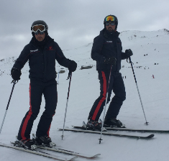
Ski Time
5 hours of lessons per day(3 hours in the morning & 2 in the afternoon)
Lunch is provided on the slopes or at the bottom of the lifts
FFP2 grade masks must be worn on the Airplane, Busses, Restaurants Ski Lifts, Indoor arenas.
No Free skiing irrespective of skiing ability (Students will be taken of the slopes if this rule is not observed,)
We understand that some students have plenty of ski experience, but they must understand that the school’s ski rules apply when travelling with the school.
All students must follow their ski instructor’s rules during lessons
Levels of skiing will be decided by the instructors(as the students improve new groups will be allocated by the instructors)
Ski Police & Public Liability
Please ensure you have given us accurate information as to how many times your son or daughter has skied before.
We will do everything in our power to ensure the safety or your son/daughter on the trip

Slide 10
Diets Allergies & Medical
Nearest hospital is half an hour away
Procedures for accidents on the mountain will be given to the students in Italy

Slide 11
Procedure for accidents on the mountain while in ski lessons with the instructors.
The ski instructor is in charge of the ski group at all times.
Students must abide by the rules of the ski slopes at all times and take instruction from the ski instructor without question.
Skiing -no free skiing at any time – students must be supervised at all times on the slopes.
(Each individual is responsible for the people skiing in front of them and must not ski into the path of the skier in front of them – they do not worry about the skiers behind as the same rule applies to the skier behind to watch the skier in front of them)
If a student has an accident the Ski Instructor will take charge and contact the ski medical mountain rescue team and the Ski School.
The ski school will contact the Newbridge College leader and the topflight representative and let us know what the suspected injury is and where the student will be taken to depending on the part of the mountain they are on. We (Newbridge College) will meet the medical team with the student asap.
Students will have the phone number for the teacher on duty as we will supply the duty phone number to all students and teachers on the trip. The students will be instructed that they must not contact anyone about the accident except for the teacher.
We will contact the parents of the student injured and let them know what the injury is. We need to establish what the injury is and firstly make the injured student with the medical situation our priority. It is imperative that no students contact Ireland as we want the injured student parents to hear about the injury from us with the correct medical information and not from a third party.
This can be a very stressful time for the injured student’s parent/s and they must be furnished with the correct information at all times.
Parents need the correct medical diagnosis to be relayed by phone from either Dolores/Declan/Dave or the medical team looking after their son/daughter.
We understand that the students will be worried about their friend but we will keep them informed. We need to keep them calm and as relaxed as possible and be understanding as they could be very frightened. We will of course make sure that the other students in the group are looked after and taken down the mountain safely.
We will inform as soon as is possible our headmaster or a deputy principal of all accident taking into account the need to attend to the injured student as our priority.
Dolores Quinn/Declan Corbett/David Brew.

